Slide 1
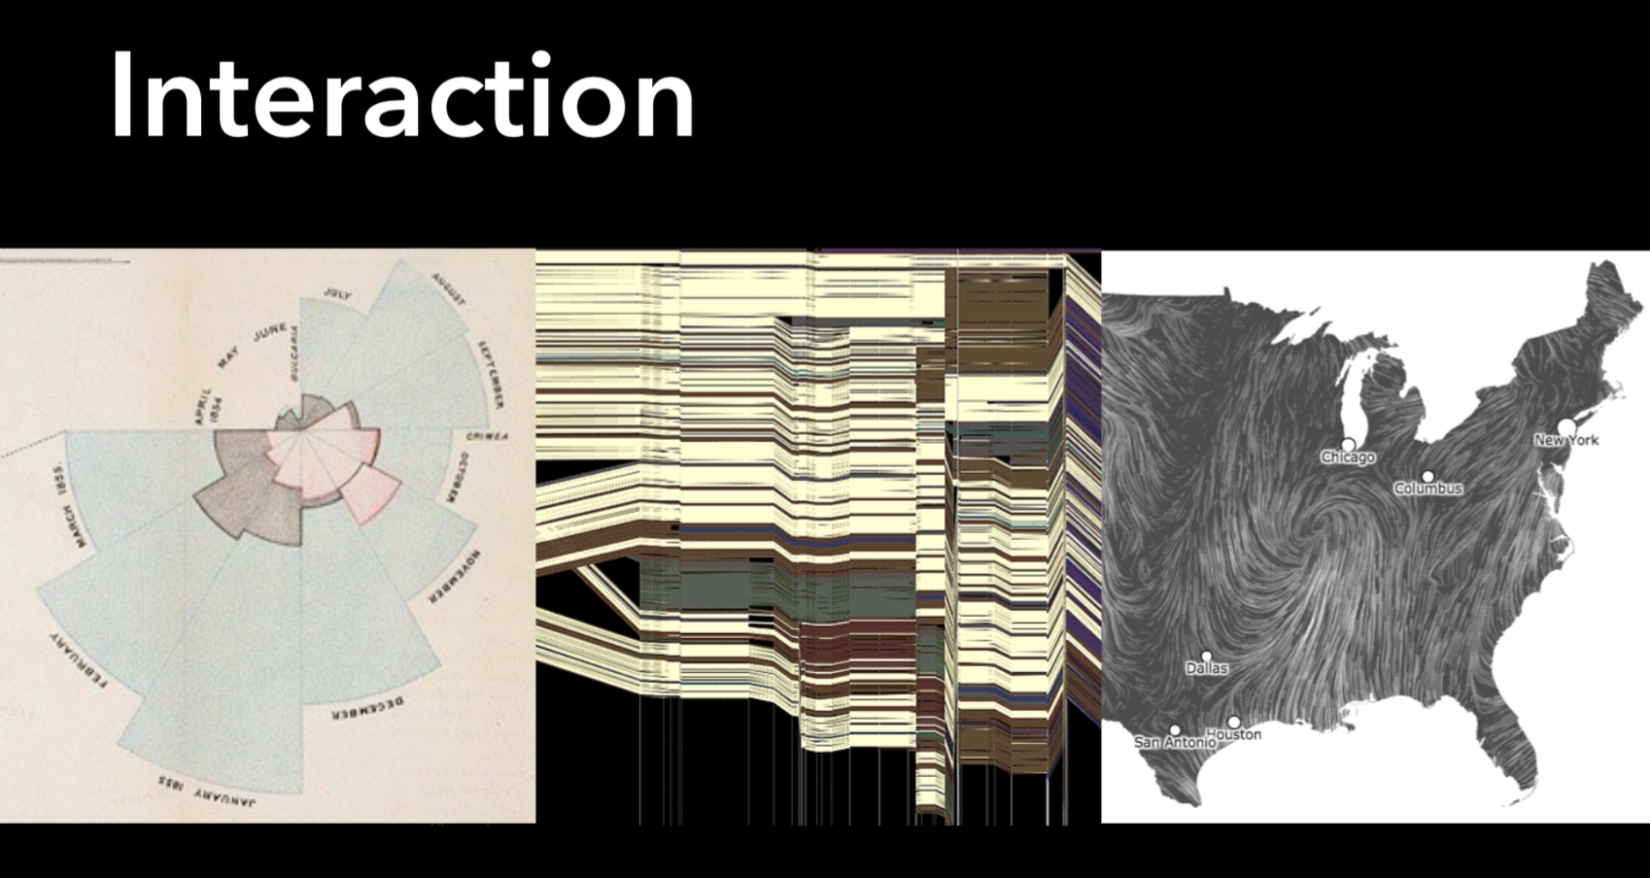
https://www.youtube.com/watch?v=XT5NzzGCAwY

Slide 4
Notes:
The Gulf of Execution
The gulf of execution is the degree to which the interaction possibilities of an artifact, a computer system or likewise correspond to the intentions of the person and what that person perceives is possible to do with the artifact/application/etc. In other words, the gulf of execution is the difference between the intentions of the users and what the system allows them to do or how well the system supports those actions (Norman 1988). For example, if a person only wants to record a movie currently being shown with her VCR, she imagines that it requires hitting a 'record' button. But if the necessary action sequence involves specifying the time of recording and selection of a channel there is a gulf of execution: A gap between the psychological language (or mental model) of the user's goals and the very physical action-object language of the controls of the VCR via which it is operated. In the language of the user, the goal of recording the current movie can be achieved by the action sequence "Hit the record button," but in the language of the VCR the correct action sequence is:
1) Hit the record button. 2) Specify time of recording via the controls X, Y, and Z. 3) Select channel via the channel-up-down control. 4) Press the OK button.
Thus, to measure or determine the gulf of execution, we may ask how well the action possibilities of the system/artifact match the intended actions of the user.

Slide 5
The Seven Stages of Action
Notes:
The Gulf of Evaluation
The gulf of evaluation is the degree to which the system/artifact provide representations that can be directly perceived and interpreted in terms of the expectations and intentions of the user (Norman 1988). Or put differently, the gulf of evaluation is the difficulty of assessing the state of the system and how well the artifact supports the discovery and interpretation of that state (Norman 1991). "The gulf is small when the system provides information about its state in a form that is easy to get, is easy to interpret, and matches the way the person thinks of the system" (Norman 1988: p. 51).
Thus, if the system does not "present itself" in a way that lets the user derive which sequence of actions will lead to the intended goal or system state, or derive whether previous actions have moved the user closer to her goal, there is a large gulf of evaluation. In this case, the person must exert a considerable amount of effort and expend significant attentional ressources to interpret the state of the system and derive how well her expectations have been met. In the VCR example from above, the design of the controls of the VCR should thus 'suggest' how to be used and be easily interpretable (e.g. when recording, the 'record' control should signal that is is activated or a display should).
To sum up, the gulfs of evaluation and of execution refer to the mismatch between our internal goals on the one side, and, on the other side, the expectations and the availability of information specifying the state of the world (or an artifact) and how me may change it (Norman 1991).

Slide 8
R = .167
Slope = .19

Slide 11
Don Norman and His Theory on Emotional Design

Slide 31
Notes:
What are dropped frames? Well, that’s when your capture card does not take in all the information it is given. Information is lost, and the video quality is degraded because of it. Information is now missing when a frame has been lost or “dropped”.

Slide 35
Notes:
http://bertin.r-forge.r-project.org/bertinR.pdf

Slide 36
Notes:
Take some class time to figure out what is actually being displayed here.
Display of a data matrix: Hotel data. Variables are shown as rows. To make periodic structures more visible, time is duplicated. Observations above average are highlighted.
In abstract terms, a Bertin matrix is a matrix of displays. Bertin matrices allow rearrangements to transform an initial matrix to a more homogeneous structure. The rearrangements are row or column permutations, and groupings of rows or columns. To fix ideas, think of a data matrix, variable by case, with real valued variables. For each variable, draw a bar chart of variable value by case.

Slide 37
Notes:
Display of a data matrix: Hotel data. Variables are rearranged by similarity to occupation and duration.
As Bertin points out, the indexing used is arbitrary. You can rearrange rows and/or columns to reveal the information of interest. If you run a hotel, of course the per- centage of hotel occupation and the duration of the visits are most interesting for you. Move these variables to the top of the display, and rearrange the other variables by similarity or dissimilarity to these target variables.

Slide 38
Notes:
Variables need not enter at their face value; they can be transformed, or derived variable can be added. In the case of the hotel data, this has already done in the original data set. For example, the guests have been classified in tourists and business, and both sum up to 100%. If we want, we can remove this redundant information. This may clean up the picture. But it may hide information. For example, tourists are “anti-cyclic” to the hotel occupation and just fill the gaps. Removing this variable because it is (1 − business) would hide this point.

Slide 39
Notes:
A device made by French cartographer Jacques Bertin for exploring tabular data, developed in the mid 1960s.

Slide 41
https://vimeo.com/102603454
Notes:
Even the Bretifier is a bit obsolete… ☺

Slide 43
Notes:
In this sample frame from the video, John Tukey sits in front of the Prim-9 hardware -- and the blackboard he uses in his explanation of the variables in the particle physics data.
If there ever was a tool that could stimulate the imagination and profit from the intuition and creativity of John Tukey, it was computer graphics. John always saw graphics a being central to exploratory data analysis: "Since the aim of exploratory data analysis is to learn what seems to be, it should be no surprise that pictures play a vital role in doing it well. There is nothing better than a picture for making you think of questions you had forgotten to ask (even mentally)." Much of his work focused on static displays designed to be easily drawn by hand, but he realized that if one wanted to effectively explore multivariate data, computer graphics would be an ideal tool. PRIM-9, the first program to use interactive, dynamic graphics for viewing and dissecting multivariate data, was conceived by John during a four month visit to the Computation Research Group of the Stanford Linear Accelerator Center in early 1972. PRIM-9 opened up a fundamentally new way of exploring multivariate data. Its basic operations--Picturing, Rotation, Isolation and Masking--have stood the test of time and form the core of numerous follow-on systems.
John's experiences with PRIM-9 gave rise to a slew of other ideas for the analysis of multivariate data, many of them not tied to interactive graphics. The most well known of those is "Projection Pursuit"--automatically finding interesting low-dimensional projections of multivariate data by optimizing a projection index. John was also keenly interested in ways of detecting and modeling nonlinear structures in multivariate data which might not be manifest in projections, such as concentration of data near nonlinear lower dimensional manifolds. Many of his proposals exist only in the form of hand-written notes and appear "far out" even today.
John's work on Prim-9 and Projection Pursuit lent respectability to computationally oriented, non mathematical research in Statistics. He moved the center of gravity away from an (over)emphasis on mathematical theory to a greater balance between methodology, theory, and applications and thereby helped revitalize the discipline of Statistics.

Slide 45
John's work on Prim-9 and Projection Pursuit lent respectability to computationally oriented, non mathematical research in Statistics.
He moved the center of gravity away from an (over)emphasis on mathematical theory to a greater balance between methodology, theory, and applications and thereby helped revitalize the discipline of Statistics.

Slide 48
Notes:
Any guesses as to what this repreents?

Slide 49
Notes:
Maybe airplane hubs?

Slide 50
Notes:
Or maybe not… you may want to do a region selection?

Slide 51
Notes:
We will only touch on this very lightly… one could take a whole class on this topic…

Slide 72
Notes:
Spence and Tweedie’s thesis can be illustrated by the task of home finding. The prospective buyer will enter an estate agent’s office with only an imprecisely formulated need (‘‘not more than £60K, hopefully more than two bedrooms and quite close to a railway station’’) and with little or no knowledge of available houses. The first need here is to explore the available houses to gain insight into general characteristics (‘‘prices increase steeply near that park’’; ‘‘there’s no chance of a third bedroom at £60K’’), so that a more focussed question can be posed. Exploration of this kind will eventually lead to the identification of a house deemed acceptable, though it may not satisfy many or even any of the original subjectively expressed requirements. Similar remarks apply to a wide variety of tasks, for example the problem faced by a marketing manager within an investment house in deciding upon a new marketing strategy on the basis of accumulated data.

Slide 73
Attribute Explorer (Spence & Tweedie, 96)
The Attribute Explorer is characterized by its graphical representation and presentation of data, and by the nature of the interaction it supports. It is the interactive and graphical exploration of data that, in our opinion, facilitates the user’s acquisition of insight into that data.

Slide 74
Attribute Explorer (Spence & Tweedie, 96)
In this context, we are reminded of a Chinese proverb to which we have added the last line:
I hear and I forget, I see and I remember, I interact and I understand, I interact responsively and I discover.

Slide 75
Attribute Explorer (Spence & Tweedie, 96)
I hear and I forget, I see and I remember, I interact and I understand, I interact responsively and I discover.
where, by ‘responsively’, we mean that an effect is perceived in less than about 0.1 s following its cause.
https://www.redfin.com

Slide 76
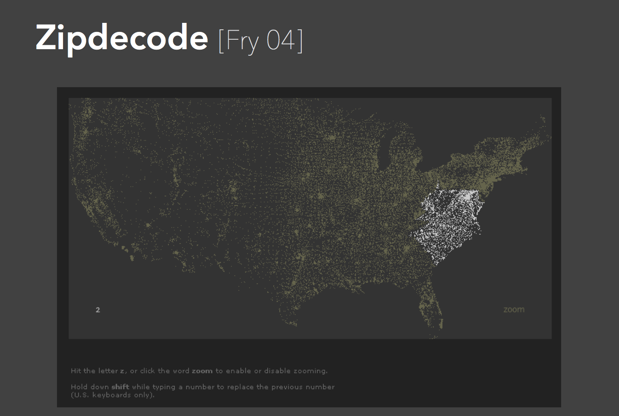
http://benfry.com/zipdecode/
Notes:
This project began a very short sketch (a few hours) that I created in 1999 because I was curious about how the numbering works for postal codes in the states.

Slide 77
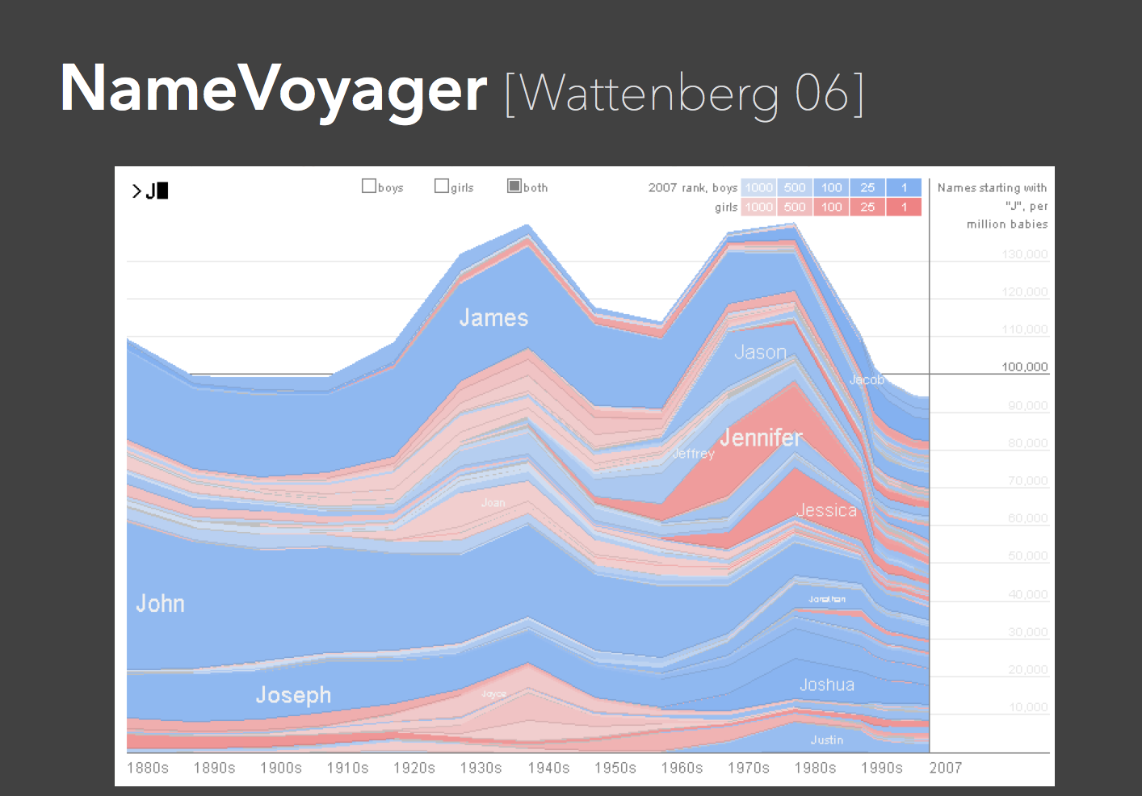
http://www.babynamewizard.com/voyager#prefix=&sw=both&exact=false

Slide 78
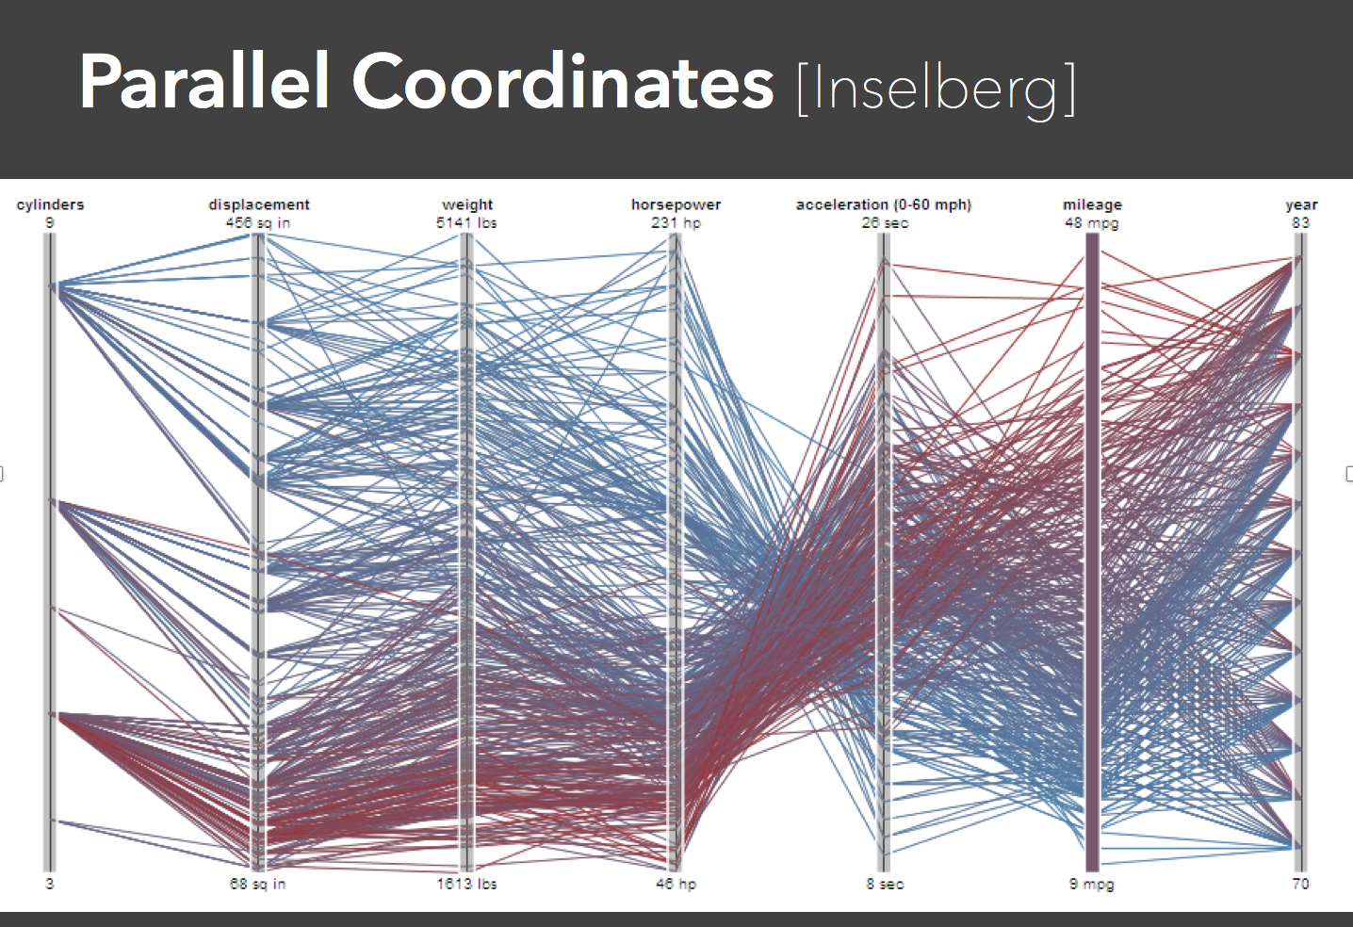
https://www.youtube.com/watch?v=gwjqlzDSSQg

Slide 79
https://www.youtube.com/watch?v=VWx1TMcrb74

Slide 80
Notes:
Figure 3: Sequence of dynamic queries identifying the spatial organization of fiber pathways.
All 13,000 pathways computed using the STT algorithm. Patterns are difficult to discern because of all the visual clutter.
Using a length filter, we show only the pathways that are greater than 40mm in length (30 percent of the total number of pathways).
By placing VOI 1 in the scene, we show only the pathways that pass through the internal capsule (bottom).
By placing VOIs 2 and 3, we obtain a picture showing connections between 1 and either 2 or 3.

Slide 81
https://www.youtube.com/watch?v=GKOdWf1NBBM
Notes:
Diffusion Tensor Imaging (DTI) is a magnetic resonance imaging method that can be used to measure local information about the structure of white matter within the human brain. Combining DTI data with the computational methods of MR tractography, neuroscientists can estimate the locations and sizes of nerve bundles (white matter pathways) that course through the human brain. Neuroscientists have used visualization techniques to better understand tractography data, but they often struggle with the abundance and complexity of the pathways.
In this paper, we describe a novel set of interaction techniques that make it easier to explore and interpret such pathways. Specifically, our application allows neuroscientists to place and interactively manipulate box-shaped regions (or volumes of interest) to selectively display pathways that pass through specc anatomical areas. A simple and exible query language allows for arbitrary combinations of these queries using Boolean logic operators.
Queries can be further restricted by numerical path properties such as length, mean fractional anisotropy, and mean curvature. By precomputing the pathways and their statistical properties, we obtain the speed necessary for interactive question-andanswer sessions with brain researchers. We survey some questions that researchers have been asking about tractography data and show how our system can be used to answer these questions efficiently.
Figure 1: The corona radiata. Our system uses dynamic queries to find structure in neural pathways suggested by MR tractography.

Slide 85
Interaction Activity and Task
In the context of the Chinese proverb:
I hear and I forget, I see and I remember, I interact and I understand, I interact responsively and I discover.
Please add your favorite “attribute explorer” website to the Canvas page!

